Slide 1
How to debug a website using IE F12 tools
David Catuhe | Principal Program Manager
Etienne Margraff | Technical Evangelist

Slide 2
Course Topics
How to debug a website using IE F12 tools
01 | Working with web standards | 02 | Debugging with the console and the debugger windows
03 | Optimizing your page | 04 | Developing a mobile web site
05 | Testing on all browsers

Slide 3
02 | Debugging with the console and the debugger windows
David Catuhe | Principal Program Manager
Etienne Margraff | Technical Evangelist

Slide 4
Module Overview
Brief history
Using the console
Debugger

Slide 5
What is the Console?
The console is where a user can see output from JavaScript
This includes errors as well as informational messages
Also allows user (or developer) to execute JavaScript code within the context of the current document
Accessed in most browsers by pressing F12
Note that the console is part of the F12 developer tools, but there are many other tools in there as well!

Slide 6
Debugging with the console and the debugger windows Brief History

Slide 7
Brief History
First appeared for Microsoft in IE8
Huge improvements made in IE11
Added console.debug()
Added in-console object expansion
Various others methods added (i.e. time/timeEnd)
Notes:
In IE 8, if you tried to use window.console.log(...) in a page it would throw a Reference Error unless the user had opened the dev tools. This was usually handled with a simple check around the function call: if (window.console) { /* use the console */ }

Slide 8
Debugging with the console and the debugger windows Using the console

Slide 9
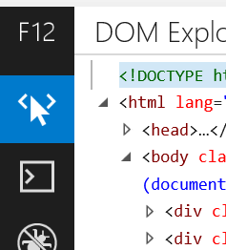
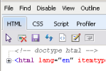
Opening the Console
Hit the F12 key to open, or use a menu option (The menu location changed over time, but generally under "Tools")
Before IE11, you then click on "Script" at the top
Beginning in IE11, you click the "Console" icon on the left

Slide 10
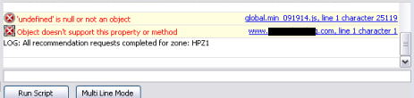
Viewing Errors
When JavaScript errors occur on the page, this is where the messages appear:
Clicking on the blue text will take you to the offending line
Notes:
Note the "LOG" statement at the bottom, that is a developer-created message from within the web application (more on those later).
Unfortunately, if the JS code is minified, clicking on the blue text won't help much (and IE11 does not support sourcemaps).

Slide 11
Basic Log Usage
The last line in the console from the previous slide shows a "LOG" message
These messages can be sent by the web application to the console
Because these are easily visible, and for efficiency, they should be limited to only critical information
In IE 10 and under the available logging levels are:
log, info, warn, and error (debug was added in IE11)
Each log level will appear slightly different in the console

Slide 12
Basic Log Usage
Function signature:
window.console[LEVEL](messageOrVariable[, messageOrVariable, ...]);
Log a simple message:
window.console.log("This is not-so-secret message!");
Log an "info" message and variable value:
window.console.info("Blog article ID: ", article.id);
Notes:
Note that since "window" is the default context, generally you can simply use: `console.log(...)` without `window.` in front

Slide 13
Logging Variables
You can log any number of variables to the console, but before IE11 only the String value is printed:
var data = { "foo": "bar" };
console.log("Here's the data: ", data);
Output:
LOG: Here's the data: [object Object]
Notes:
You get "[object Object]" because calling .toString() on most objects will produce this unless the developer has overridden that method.

Slide 14
Logging Variables
Instead, prior to IE11, you have to log individual properties
This includes individual members of an array:
var data = { "foo": "bar" };
console.log("Here's the data: ", data["foo"]);
Output:
LOG: Here's the data: bar
Notes:
You get "[object Object]" because calling .toString() on most objects will produce this unless the developer has overridden that method.

Slide 15
Inspecting Objects
Beginning with IE11 (and in most other browser dev tools) we can inspect objects:
var data = { "foo": "bar" };
console.log("Here's the data: ", data);
Output (IE11):
▶ Here's the data: [object Object]
Notes:
This may look the same, but when clicking that arrow we get more information on the object (see next slide)

Slide 16
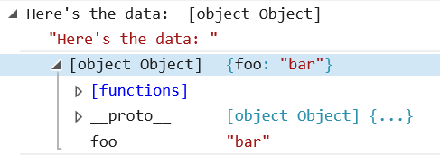
Inspecting Objects
In IE11 we can click the arrow below to expand the output and see the properties of the object:
console.log("Here's the data: ", data);

Slide 17
Debugging with the console and the debugger windows Demo

Slide 18
Running Arbitrary Code
In addition to basic logging, any JavaScript code that could be run in the application is available.
The return value from the method will be printed below the command.
Simply type something like this in the input box:
callSomeMethod("input");
And you will get some output:
"You gave me some input"
Notes:
Note that if the method does not "return" anything you will see "undefined" in the output

Slide 19
Logging in Applications
Using console statements in application code can make debugging easier:
function someTrickyLogic(input) {
console.debug("About to do tricky logic using: ", input);
...
console.debug("Tricky logic resulted in: ", someResult);
return someResult;
}

Slide 20
Logging in Applications
Additionally, we can add warnings for things like deprecated methods:
function oldLogic(input) {
console.warn("This method is deprecated, please use 'newMethod'");
...
}

Slide 21
Logging in Applications
Or to warn about issues that the developer should look at, but which should not stop execution:
function getAdContent() {
var ad = app.getNextAd();
if (ad.error){
// don't fail just because of a missing ad...
console.warn("Unable to get next ad: ", ad.error);
return;
}
...
}

Slide 22
Logging Variables
In IE11 we can explicitly ask the console to log a variable in either DOM (XML) mode or Object mode:
function generateContent() {
var box = document.createElement("div");
...
console.dirxml(box); // print out as a DOM node
console.dir(box); // print out as an object with properties
}

Slide 23
Debugging with the console and the debugger windows Demo

Slide 24
Grouping Messages
If you have a lot of messages in one place, you can group them for easier readability:
function lotsOfStuff() {
console.group("group name"); // begin a group
// lots of logic and messages
console.groupEnd(); // close the group
}
When displayed, the messages can now be collapsed (or expanded) for convenience

Slide 25
Checking Execution Time
In IE11, if we need to see how long an action is taking, use the "time" methods:
function takingTooLong() {
console.time(); // start the timer
// lots of logic...
console.timeEnd(); // end the timer
}
When the timer stops, the total milliseconds are printed in the console

Slide 26
Removing Unnecessary Logs
If we don't want to remove all console.* statements, we could use a wrapper with a logging level:
var logLevel = 2;
var _debug = window.console.debug;
window.console.debug = function () {
if (logLevel < 1) {
_debug.apply(window.console, [].splice.call(arguments, 0));
}
};
Notes:
This is an overly simplified example, but you can see that we cache the original debug method, then overwrite it in order to determine whether or not to call the original based on the current logging level.

Slide 27
Debugging with the console and the debugger windows Demo

Slide 28
Debugging with the console and the debugger windows Debugger

Slide 29
Debugger
Dropdown contains all JavaScript on the page
Can add breakpoints to pause execution at that point
Can go step by step through the code
Pause on exceptions
Prettify minified code for debugging in production if needed
Call stack for seeing code execution path
Add watchers for current value of a variable
Use in tandem with console for great debugging experience

Slide 30
Debugger Example
There’s a bug in this code! It always shows the file number even if an element was dragged
Dropzone.prototype.onDrop = function (event) {
var files = event.dataTransfer.files;
if (files) {
console.log("you dropped: " + files.length + " files.");
}
else {
console.log("you dropped: " + event.dataTransfer.getData("text"));
}
event.preventDefault();
};
Notes:
Here’s some sample code

Slide 31
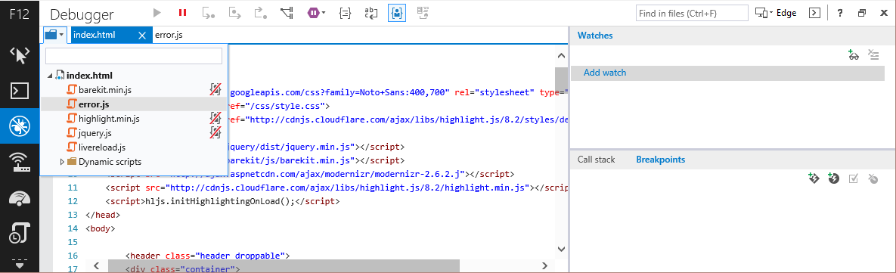
Debugger Example
Select a file using the dropdown and filter
Notes:
This allows you to pick a file, and you can type in the box to find a specific file.
The red cross tells you which files are yours versus 3rd party libraries

Slide 32
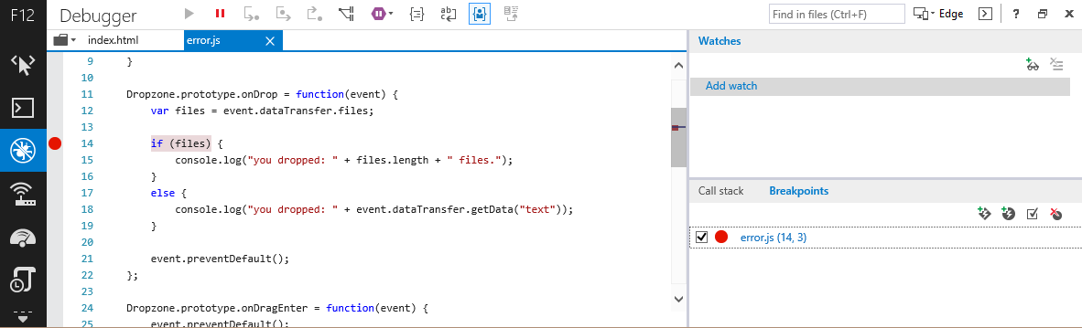
Debugger Example
With the F12 Tools debugger, you can add a breakpoint to see what’s happening
Notes:
Click in the left gutter to add a breakpoint.
Also, the purple pause button tells the tools to break on exception
The curly brace icon is what allows you to prettify code

Slide 33
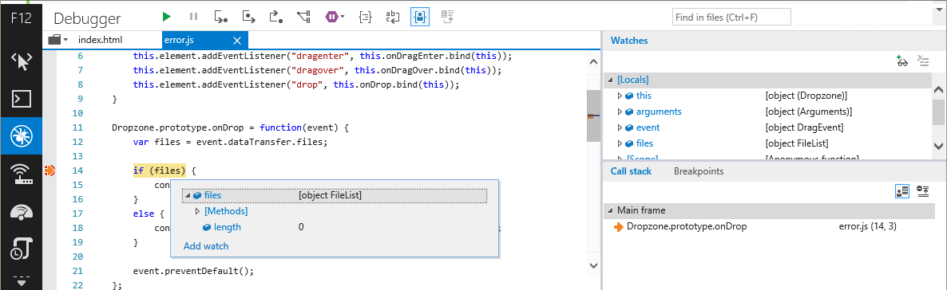
Debugger Example
Notice how the fileList is an object
This will make it pass the if statement no matter the length of the files
Hover over files, or notice locals in the Watches panel
Notes:
Here we’re hovering over files in the code, but you’ll notice you can also see the files in the right hand panel

Slide 34
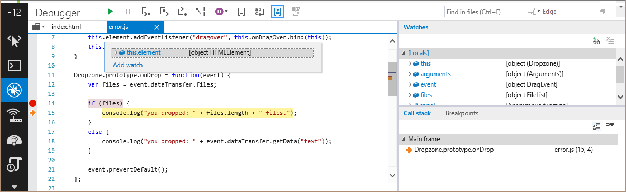
Debugger Example
Press “Step Over” or F10 to step into the if statement
Call stack shows current function execution
Notes:
There are also buttons and commands for stepping into a function, and out of a functio

Slide 35
Debugger Example
Press the “Continue” green arrow button or F5 to allow the code to stop debugging
Since files is an array, it will always evaluate as truthy
Test the files.length
if (files.length) {
console.log("you dropped: " + files.length + " files.");
}

Slide 36
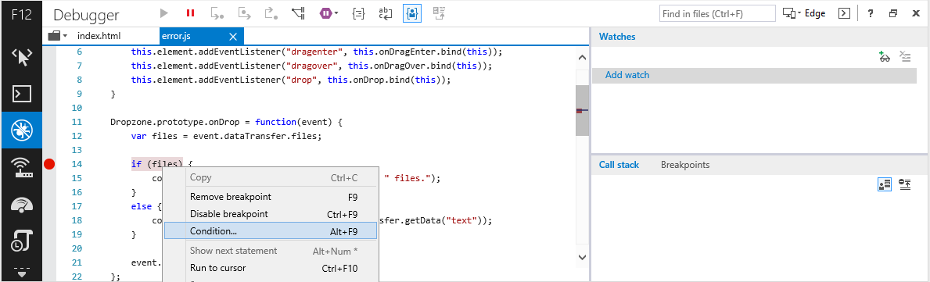
Conditional Breakpoint
Notes:
You can add a conditional breakpoint which will only fire if a certain expression evaluates as true

Slide 37
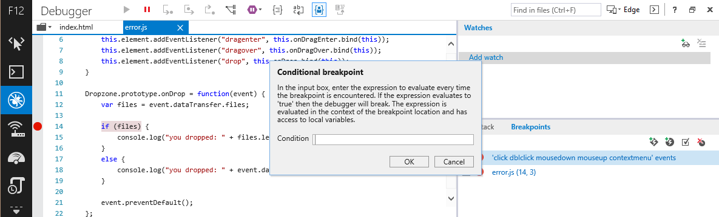
Conditional Breakpoint
Add a JavaScript expression to evaluate
If true, the breakpoint will fire

Slide 38
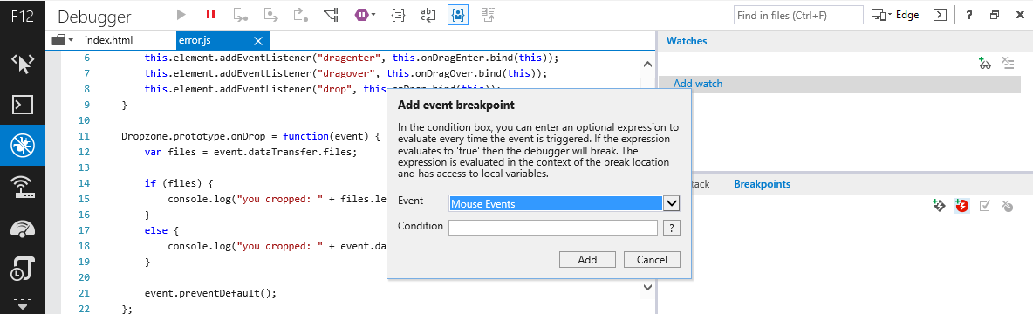
Event Breakpoint
Add an event breakpoint in the breakpoints panel

Slide 39
Debugging with the console and the debugger windows Demo

